Slide 1
The Fast Fourier Transform(FFT)
By: Cavaughn Browne
With Cooley-Tukey Algorithm Implemented

Slide 2
Introduction
The fast Fourier transform is a mathematical method for transforming a function of time into a function of frequency. Sometimes it is described as transforming from the time domain to the frequency domain. It is very useful for analysis of time-dependent phenomena.

Slide 3
Introduction Continued
Fast Fourier transforms are widely used for many applications in engineering, science, and mathematics.
In 1994, Gilbert Strang described the FFT as "the most important numerical algorithm of our lifetime.

Slide 4
How does the FFT Operate?
The FFT operates by decomposing an N point time domain signal into N time domain signals each composed of a single point. The second step is to calculate the N frequency spectra corresponding to these N time domain signals. Lastly, the N spectra are synthesized into a single frequency spectrum.

Slide 5
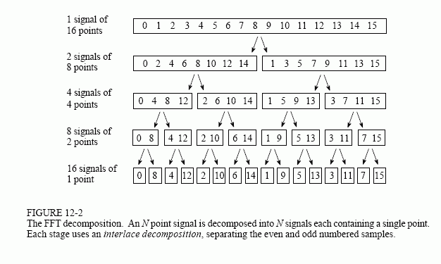
How does the FFT Operate?

Slide 6
The importance of the FFT
One important application is for the analysis of sound. It is important to assess the frequency distribution of the power in a sound because the human ear exercises that capacity in the hearing process.

Slide 7
The importance of the FFT
Importance in signal processing:
A Fourier transform of a signal tells you what frequencies are present in your signal and in what proportions.
By being able to split signals into their constituent frequencies, one can easily block out certain frequencies selectively by nullifying their contributions.
A shifted (delayed) signal in the time domain manifests as a phase change in the frequency domain. This is a widely used property in practice, especially in imaging and tomography applications (a technique for displaying a representation of a cross section through a human body or other solid object using X-rays or ultrasound).

Slide 8
The Cooley-Tukey Algorithm
COOLEY-TUKEY Algorithm and RADIX-2 DIT
The Cooley–Tukey algorithm
the most common fast Fourier transform (FFT) algorithm.
A radix-2 decimation-in-time (DIT) FFT is the simplest and most common form of the Cooley–Tukey algorithm.
Radix-2 DIT divides a DFT of size N into two interleaved DFTs (hence the name "radix-2") of size N/2 with each recursive stage.

Slide 9
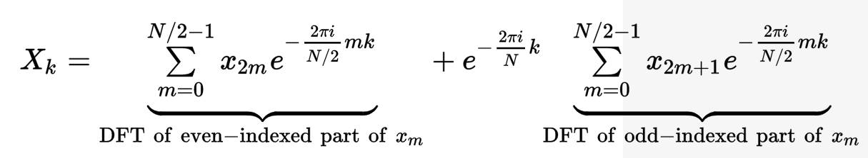

Slide 10
CODE SHOWCASE

Slide 11
Results

Slide 12
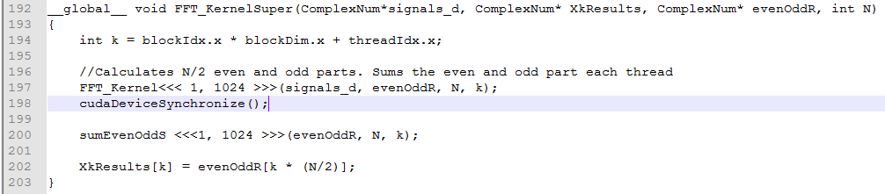
Dynamic Parallelism (add –rdc=true) N = 2048, time = 39.0ms

Slide 13
Sources
http://hyperphysics.phy-astr.gsu.edu/hbase/Math/fft.html
https://en.wikipedia.org/wiki/Fast_Fourier_transform
http://dsp.stackexchange.com/questions/69/why-is-the-fourier-transform-so-important
https://en.wikipedia.org/wiki/Cooley%E2%80%93Tukey_FFT_algorithm

